Slide 1
Deduplicating Cloud Functions - Demo 2
Members:
Beliz Kaleli
Vikash Sahu
Paritosh Shirodkar
Asutosh Patra
Mentor:
Shripad Nadgowda
Notes:
1

Slide 2
Some Recap..

Slide 3
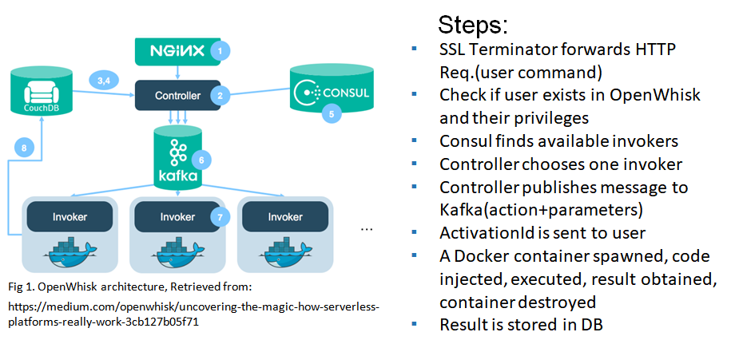
How Does Serverless Work?

Slide 4
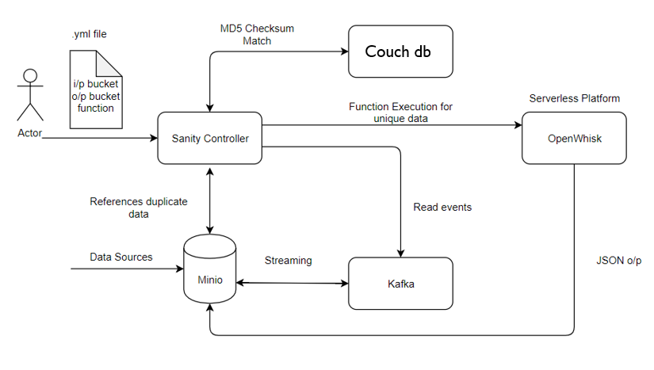
Architecture Diagram

Slide 5
Integration of Components
Minio
Kafka
Couchdb
Openwhisk

Slide 6
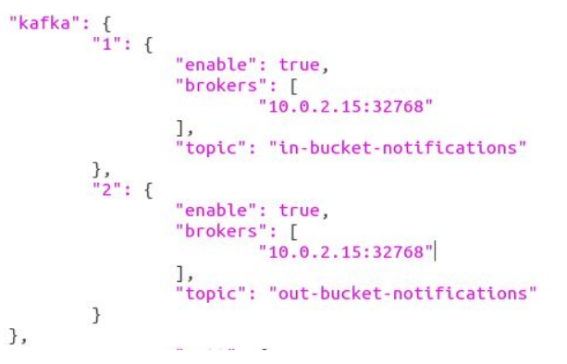



Minio
Client and Server
Configure server with Kafka
Run server
Client makes a bucket
and setup event

Slide 7


Kafka
Bucket events are monitored using Kafka
Command line Consumer and Producer
Runs in Docker
Docker -compose:
Define and run multi-container Docker applications.
Run entire app with a single command: $docker-compose up
topic name
broker name
Notes:
Can remove the kafkacat. We don’t want to mention the kafkacat

Slide 8
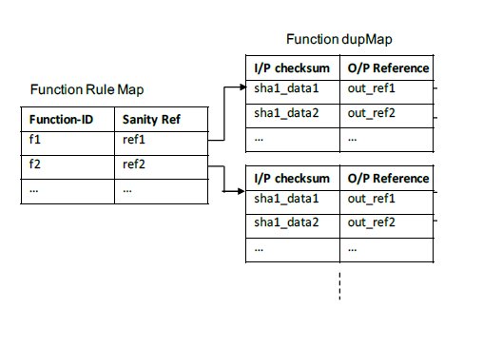
Couch DB
Nosql Database
Easier to grow a cluster
Built-in managed caching
Supports Distributed environment for data replication,fault-tolerance, load balancing

Slide 9
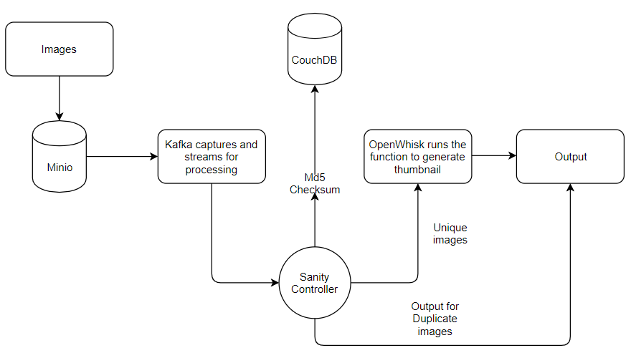
Use Case
Taking function as input from user(finding a thumbnail of an image)
Checking the MD5 checksum to identify unique data
Query is done in Couchdb
Serverless is invoked only if new data comes into play

Slide 10
DEMO

Slide 11
Challenges in Current Sprint
OpenWhisk Devtools (Docker) version not stable. Lot of functionalities are developed daily
Difficulty understanding the internal architecture and pipeline of OpenWhisk
Understanding how containers interact with each other
Understand how Kafka, Minio and Couchdb works w.r.t. Openwhisk

Slide 12
Next Steps (Sprint - 3)
Running components in different containers
Write Sanity Controller and integrate with other elements.
Implement a function deduplication system
Design new event management and function invocation framework for Cloud Object Storage

Slide 13
Learning from this Sprint
Got exposed to Open source community
Had interaction with the members of OpenWhisk
Pull requests were created and contributed in discussion
Learnt about Kafka streaming and Minio

Slide 14
Questions from Previous Sprint
Why is this being implemented as a layer on top of OpenWhisk rather than inside it?
Due to complex constraints involved, we are trying to build POC on the same architecture. Once this prototype is successful, stretch goal is to integrate it with OpenWhisk framework(difficult to complete in this time frame)
How do you know that a function has no side effect, or uses external data (e.g., from a DB)?
Serverless allows only the stateless functions to be executed and not stateful. The stateful functions are not in our scope.

Slide 15
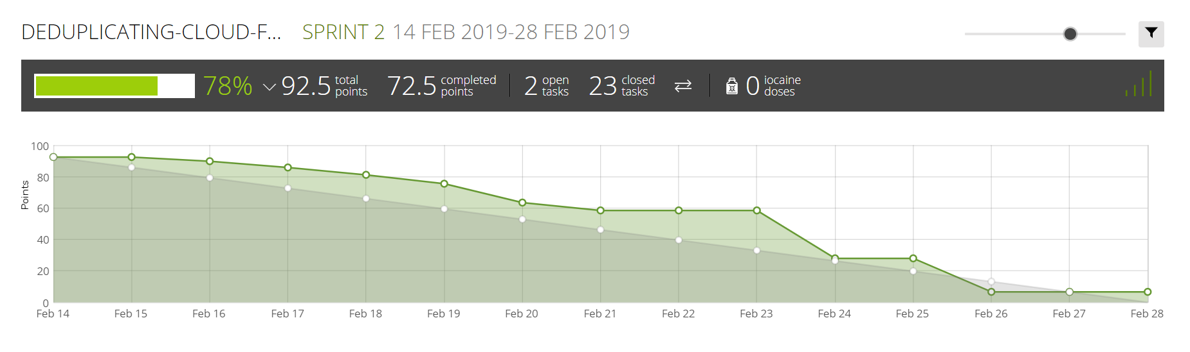
Burndown Chart

Slide 16
THANK YOU

